Slide 1
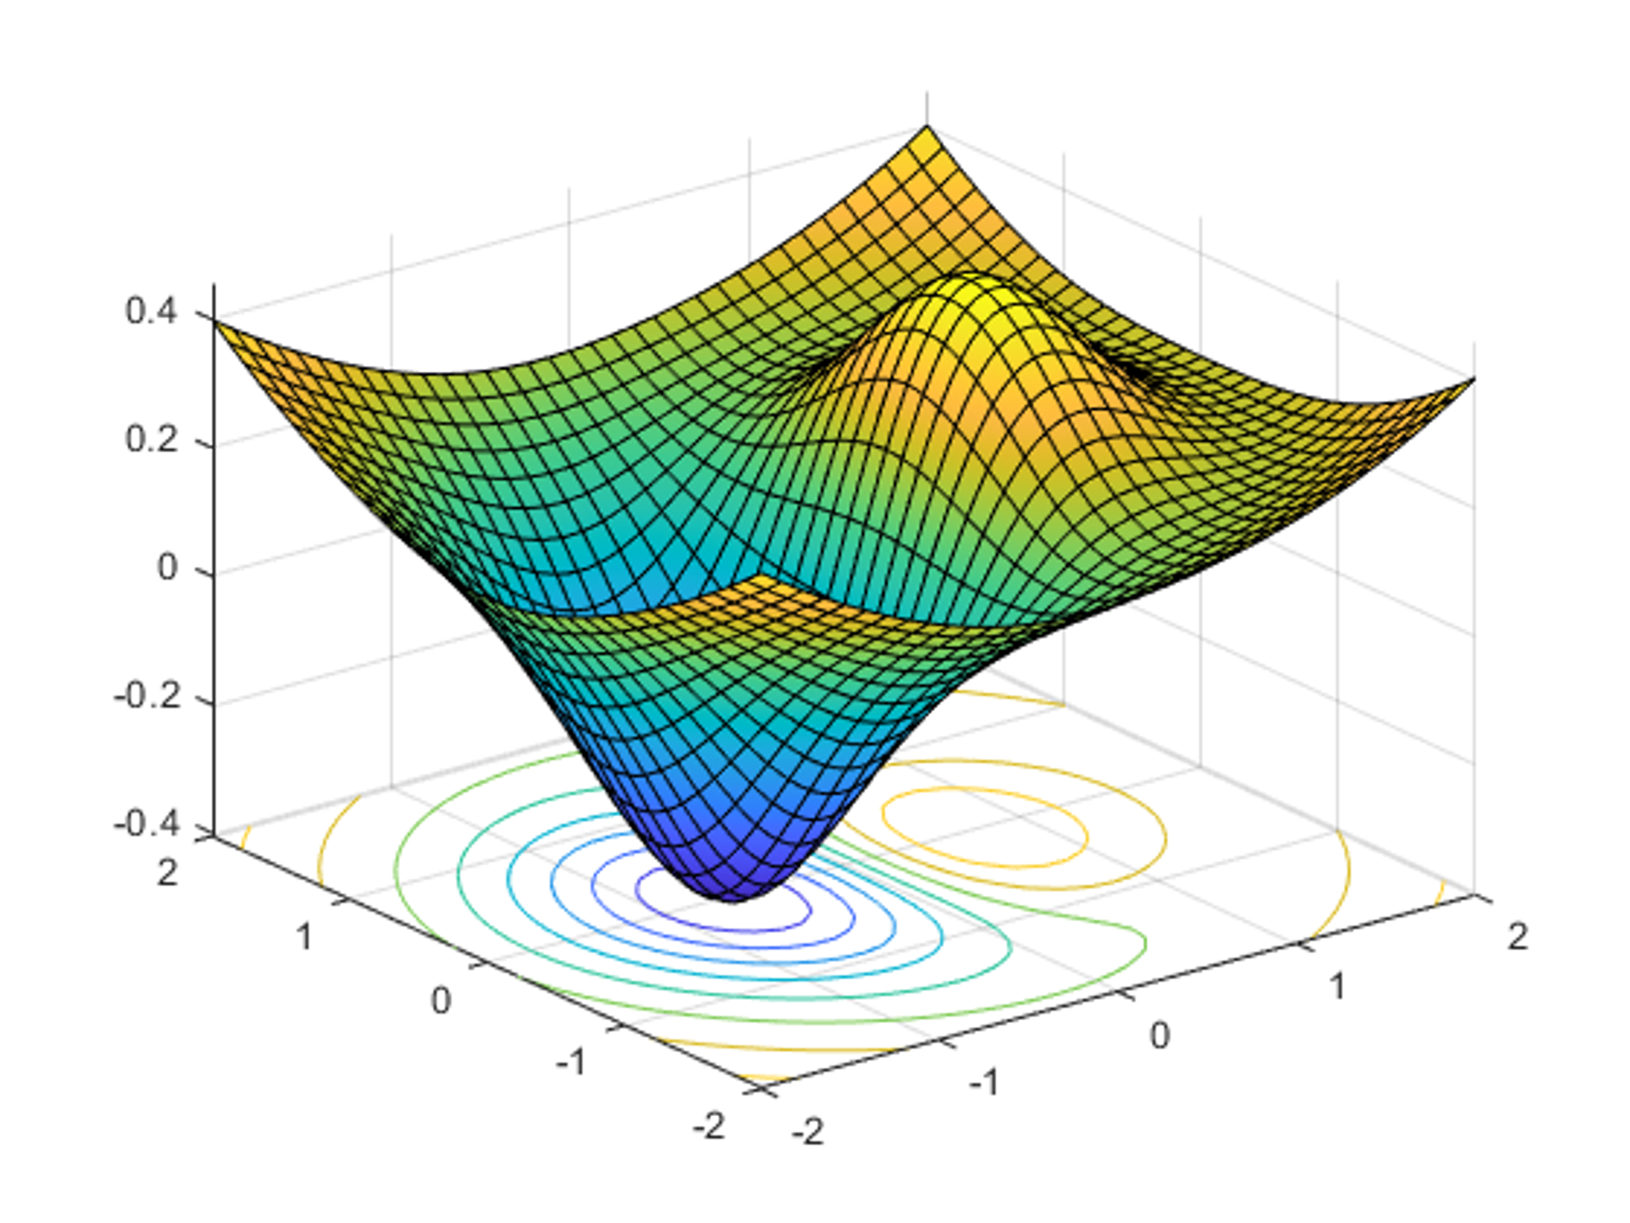


DATA 585 Optimization
Picture generated on MATLAB using
f = @(x,y) x.*exp(-x.^2-y.^2)+(x.^2+y.^2)/20;
fsurf(f,[-2,2],'ShowContours','on’)
Code example from https://www.mathworks.com/help/optim/ug/optimization-toolbox-tutorial.html
Instructor: Yves Lucet
$$\min{\{f\left(x\right):g\left(x\right)≤0;h\left(x\right)=0;x∈S\}}$$
We respectfully acknowledge the Syilx Okanagan Nation and their peoples, in whose traditional, ancestral, unceded territory UBC Okanagan is situated.

Slide 2
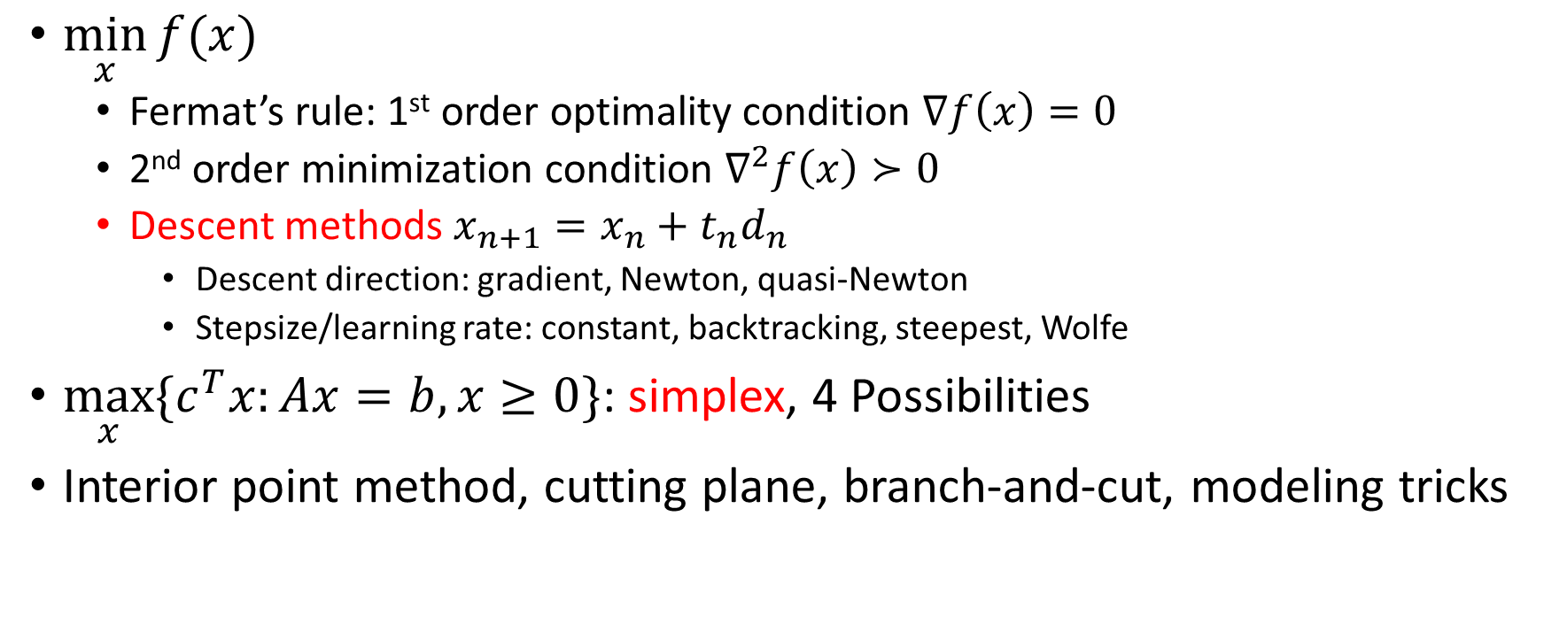
Summary
$\min_{x}{f(x)}$
Fermat’s rule: 1st order optimality condition $∇f\left(x\right)=0$
2nd order minimization condition $∇^{2}f\left(x\right)≻0$
Descent methods $x_{n+1}=x_{n}+t_{n}d_{n}$
Descent direction: gradient, Newton, quasi-Newton
Stepsize/learning rate: constant, backtracking, steepest, Wolfe
$\max_{x}{\{c^{T}x:Ax=b,x≥0\}}$: simplex, 4 Possibilities
Interior point method, cutting plane, branch-and-cut, modeling tricks

Slide 3

Menu
0. Assignment 1
Gradient descent for ML
Momentum
NAG: Nesterov’s accelerated gradient
SGD: Stochastic gradient descent
Adagrad
RMSProp
Adam, NAdam, AdamW, and variants
Lion
Hyperparameter tuning optimization algorithms
Random search
Grid search
Image courtesy of Gregory Szarkiewicz / FreeDigitalPhotos.net

Slide 4
Assignment 1
Classify
Unconstrained nonlinear; use nonlinear solver: BFGS, SLSQP, trust region; fminunc
Quadratic programming (QP); use quadprog. Avoid nonlinear solvers like fmincon, SLSQP, BFGS
Quadratic objective with quadratic constraints. Use quadratically-constrained quadratic programming (QCQP) solver; a nonlinear solver is acceptable
Solve: find the minimum (min value -0.15), not the maximum! There are 2 global minimizers
Avoid derivative-free solvers when derivatives are available, e.g., Nelder-Mead, differential evolution, COBYLA

Slide 5

Gradient descent for ML
$$w=w−η∇Q\left(w\right)$$

Slide 6
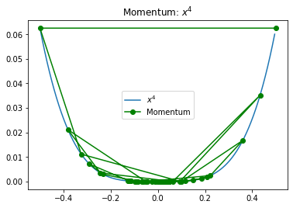
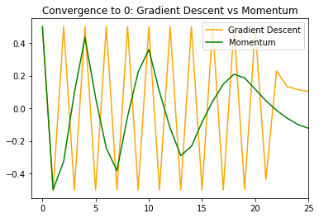


$$\text{Momentum} \text{or} \text{heavy} \text{ball} \text{method}$$
$$x_{n+1}=x_{n}−α∇f\left(x_{n}\right)+β(x_{n}−x_{n−1})$$
https://boostedml.com/2020/07/gradient-descent-and-momentum-the-heavy-ball-method.html

Slide 7
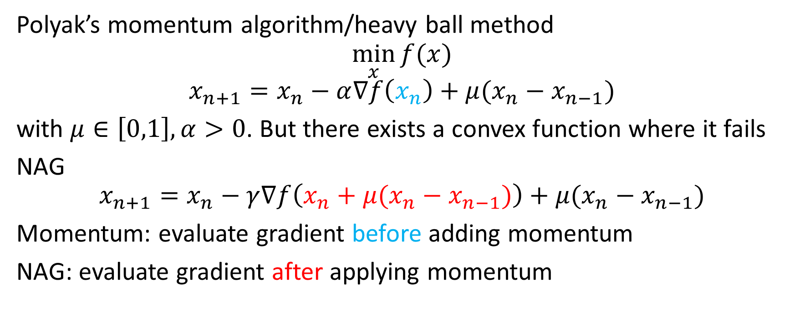
NAG: Nesterov’s accelerated gradient descent
Polyak’s momentum algorithm/heavy ball method
$$\min_{x}{f(x)}$$
$$x_{n+1}=x_{n}−α∇f\left(x_{n}\right)+μ(x_{n}−x_{n−1})$$
with $μ∈\left[0,1\right], α>0$. But there exists a convex function where it fails
NAG
$$x_{n+1}=x_{n}−γ∇f\left(x_{n}+μ(x_{n}−x_{n−1})\right)+μ(x_{n}−x_{n−1})$$
Momentum: evaluate gradient before adding momentum
NAG: evaluate gradient after applying momentum
Chapter 4
Optimization for Data Analysis, Stephen J. Wright, 2022 https://doi.org/10.1017/9781009004282

Slide 8
Adam optimizer
Named derived from adaptive moment estimation but written Adam
Uses first and second moment estimates of gradient to adapt learning rate
Improvement over previous adaptive optimization techniques: AdaGrad, RMSP
Better at generalizing performance
Intuitive interpretation of hyperparameters require less tuning
Sometimes Adam does not converge while SGD does
Adam is combination of momentum and RMSP

Slide 9
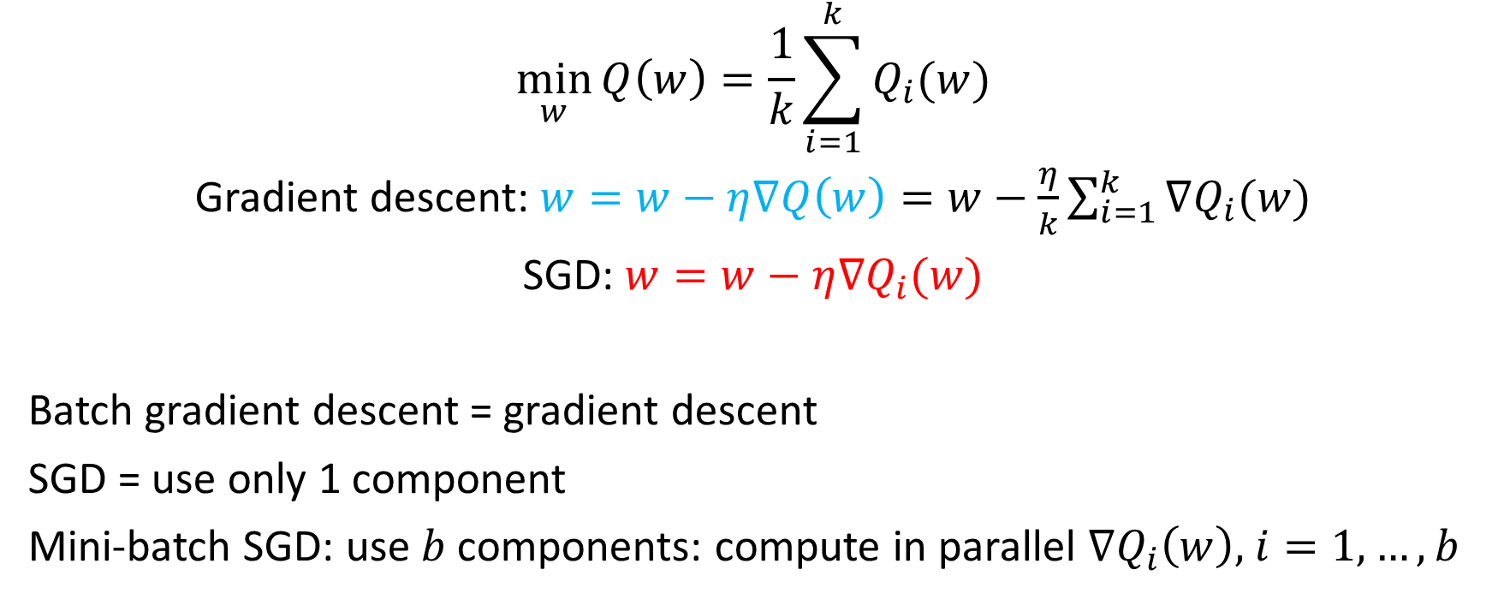
SGD: Stochastic Gradient Descent
$$\min_{w}{Q\left(w\right)=\frac{1}{k}\sum_{i=1}^{k}{Q_{i}(w)}}$$
Gradient descent: $w=w−η∇Q\left(w\right)=w−\frac{η}{k}\sum_{i=1}^{k}{∇Q_{i}(w)}$
SGD: $w=w−η∇Q_{i}(w)$
Batch gradient descent = gradient descent
SGD = use only 1 component
Mini-batch SGD: use $b$ components: compute in parallel $∇Q_{i}\left(w\right),$ $i=1,…,b$

Slide 10
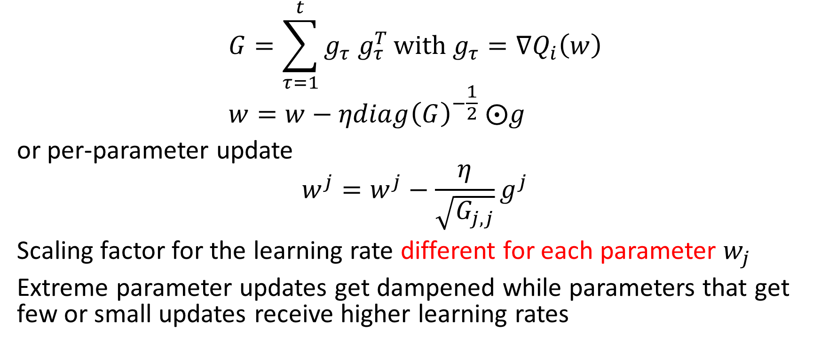
AdaGrad: adaptive gradient algorithm
$$G=\sum_{τ=1}^{t}{g_{τ}{ g}_{τ}^{T}}with g_{τ}=∇Q_{i}\left(w\right) \\ w=w−ηdiag{\left(G\right)}^{−\frac{1}{2}} ⨀g$$
or per-parameter update
$$w^{j}=w^{j}−\frac{η}{\sqrt{G_{j,j}}}g^{j}$$
Scaling factor for the learning rate different for each parameter $w_{j}$
Extreme parameter updates get dampened while parameters that get few or small updates receive higher learning rates
https://en.wikipedia.org/wiki/Stochastic_gradient_descent#AdaGrad

Slide 11
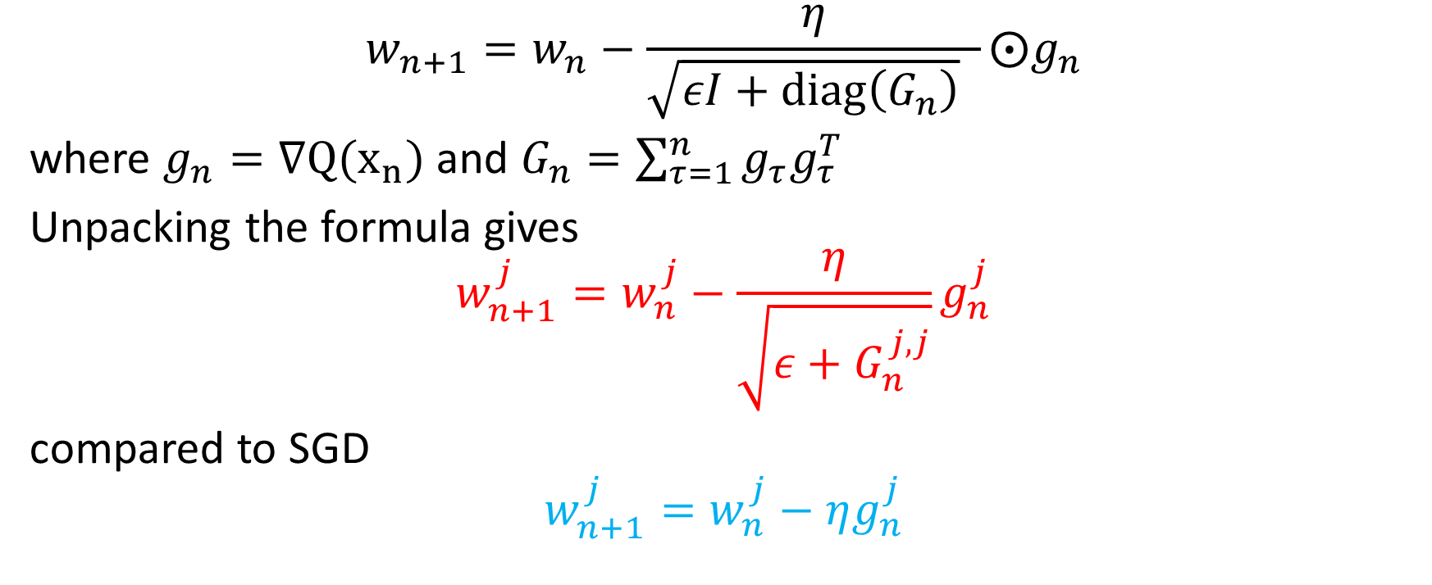
Adagrad: other implementation
$$w_{n+1}=w_{n}−\frac{η}{\sqrt{εI+diag\left(G_{n}\right)} }⨀g_{n}$$
where $g_{n}=∇Q(x_{n})$ and $G_{n}=\sum_{τ=1}^{n}{g_{τ}g_{τ}^{T}}$
Unpacking the formula gives
$$w_{n+1}^{j}=w_{n}^{j}−\frac{η}{\sqrt{ε+G_{n}^{j,j}}}g_{n}^{j}$$
compared to SGD
$$w_{n+1}^{j}=w_{n}^{j}−ηg_{n}^{j}$$
https://medium.com/konvergen/an-introduction-to-adagrad-f130ae871827
Notes:
Epsilon avoid division by zero

Slide 12
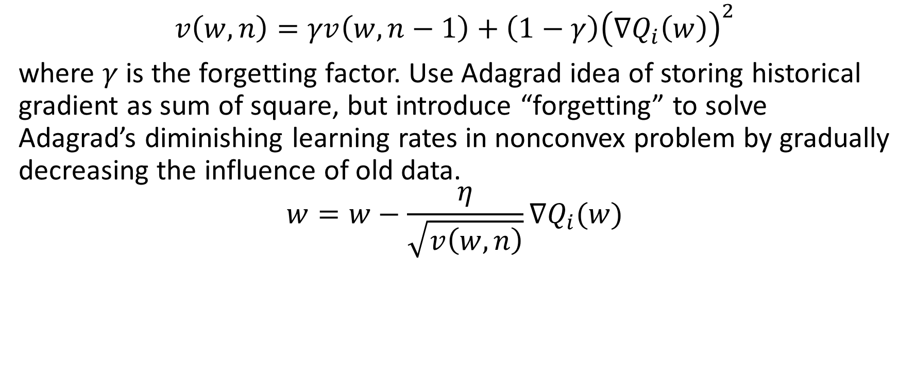
RMSProp: root mean square propagation
$$v\left(w,n\right)=γv\left(w,n−1\right)+\left(1−γ\right){\left(∇Q_{i}\left(w\right)\right)}^{2}$$
where $γ$ is the forgetting factor. Use Adagrad idea of storing historical gradient as sum of square, but introduce “forgetting” to solve Adagrad’s diminishing learning rates in nonconvex problem by gradually decreasing the influence of old data.
$$w=w−\frac{η}{\sqrt{v\left(w,n\right)}}∇Q_{i}(w)$$
https://en.wikipedia.org/wiki/Stochastic_gradient_descent#RMSProp

Slide 13
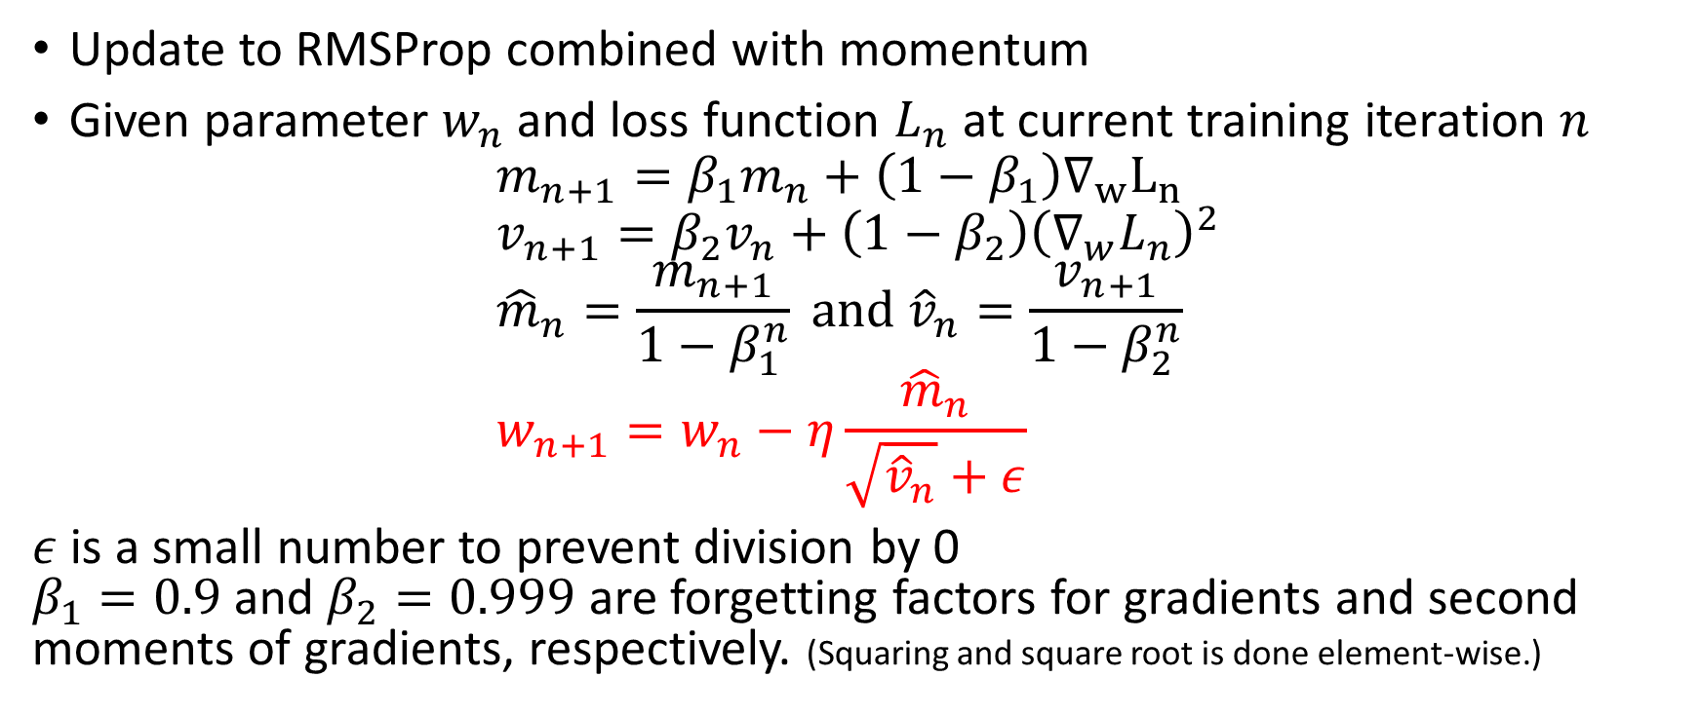
Adam: adaptive moment estimation
Update to RMSProp combined with momentum
Given parameter $w_{n}$ and loss function $L_{n}$ at current training iteration $n$
$$m_{n+1}=β_{1}m_{n}+\left(1−β_{1}\right)∇_{w}L_{n} \\ v_{n+1}=β_{2}v_{n}+\left(1−β_{2}\right){\left(∇_{w}L_{n}\right)}^{2} \\ {\hat{m}}_{n}=\frac{m_{n+1}}{1−β_{1}^{n}} and {\hat{v}}_{n}=\frac{v_{n+1}}{1−β_{2}^{n}} \\ w_{n+1}=w_{n}−η\frac{{\hat{m}}_{n}}{\sqrt{{\hat{v}}_{n}}+ε}$$
$ε$ is a small number to prevent division by 0 $β_{1}=0.9$ and $β_{2}=0.999$ are forgetting factors for gradients and second moments of gradients, respectively. (Squaring and square root is done element-wise.)
https://en.wikipedia.org/wiki/Stochastic_gradient_descent#Adam

Slide 14
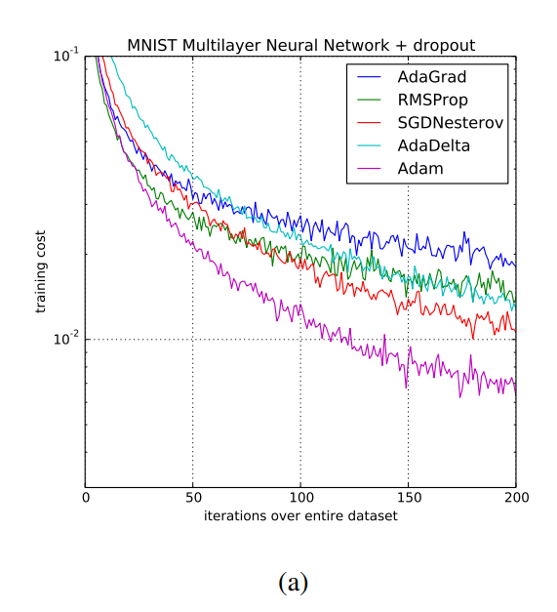
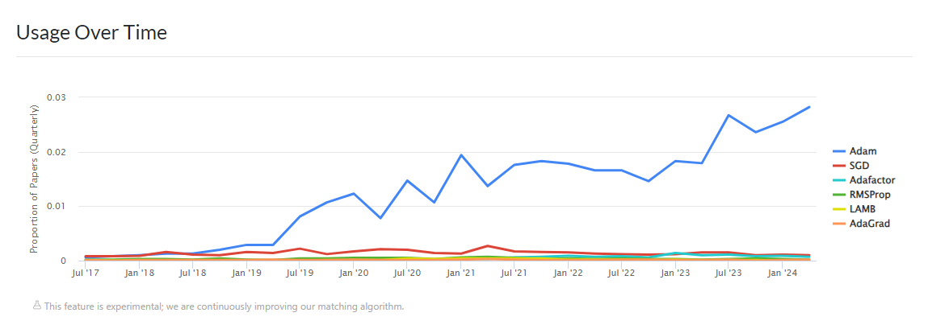
https://arxiv.org/pdf/1412.6980.pdf
https://paperswithcode.com/method/adam

Slide 15
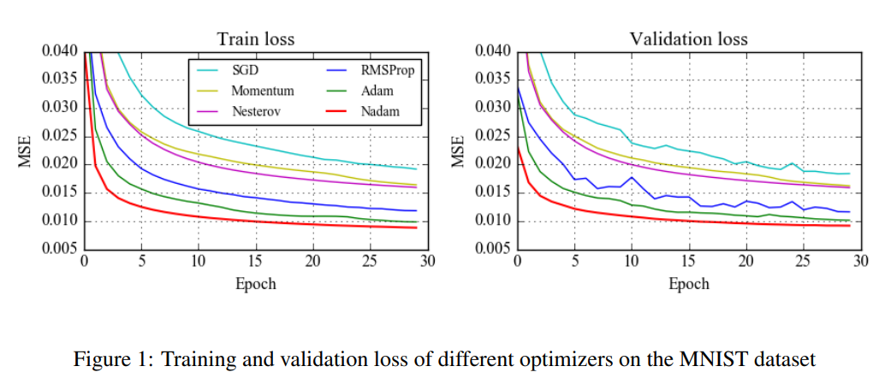
Nadam: Nesterov-accelerated Adam
https://openreview.net/pdf?id=OM0jvwB8jIp57ZJjtNEZ

Slide 16
Adam
Pros
Cons
Faster convergence than SGD
Easy to implement
Robust
Little memory requirements
Wide adoption
In some areas does not converge to an optimal solution so for some tasks (image classification on popular CIFAR datasets) state-of-the-art only achieved with SGD with momentum
Does not generalize as well as SGD with momentum
Start training with Adam then switch to SGD
https://towardsdatascience.com/adam-latest-trends-in-deep-learning-optimization-6be9a291375c

Slide 17
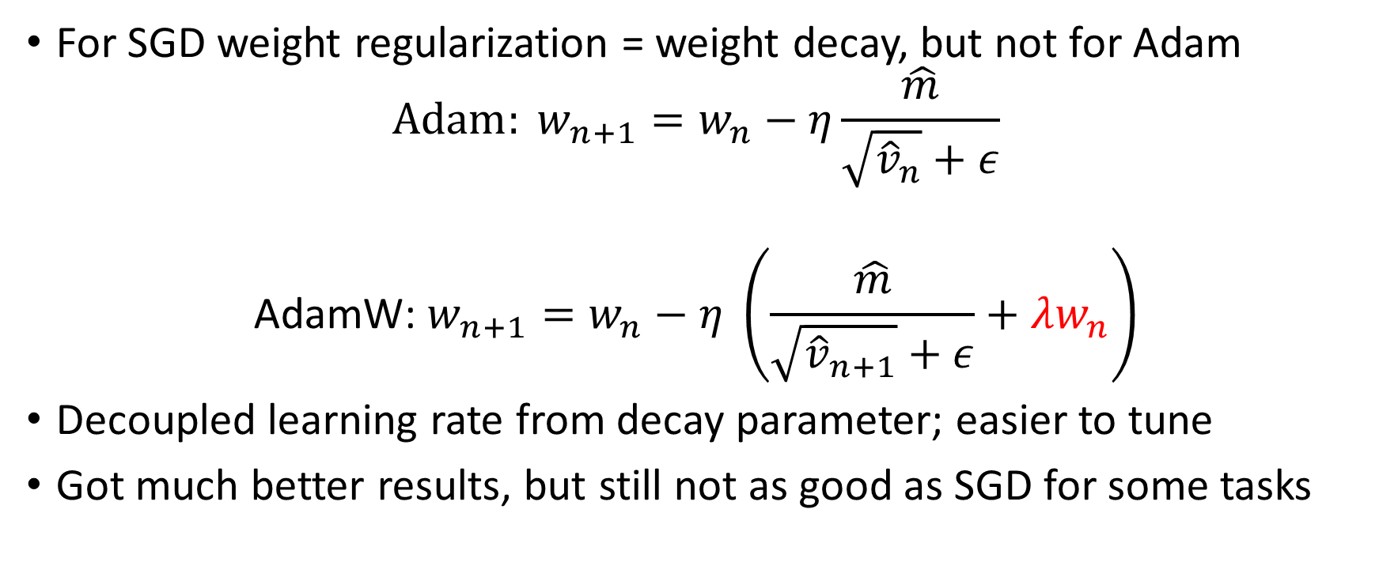
AdamW
For SGD weight regularization = weight decay, but not for Adam
$$Adam: w_{n+1}=w_{n}−η\frac{\hat{m}}{\sqrt{{\hat{v}}_{n}}+ε}$$
$${\text{AdamW}\text{:} w}_{n+1}=w_{n}−η \left(\frac{\hat{m}}{\sqrt{{\hat{v}}_{n+1}}+ε}+λw_{n}\right)$$
Decoupled learning rate from decay parameter; easier to tune
Got much better results, but still not as good as SGD for some tasks

Slide 18
Recent work
AMAdam Feb 2024 https://doi.org/10.1007/s10115-023-02052-9
ABNGrad Feb 2024 https://doi.org/10.1007/s10489-024-05303-6
sqFm Jan 2024 https://doi.org/10.1007/s12065-023-00897-1
FOAdam Apr 2024 https://doi.org/10.1016/j.apm.2023.12.018
WuC-Adam Dec 2023 https://doi.org/10.3934/mbe.2024054
AdamW, QHAdam, QHAdamW, LAMB https://www.iprally.com/news/recent-improvements-to-the-adam-optimizer

Slide 19
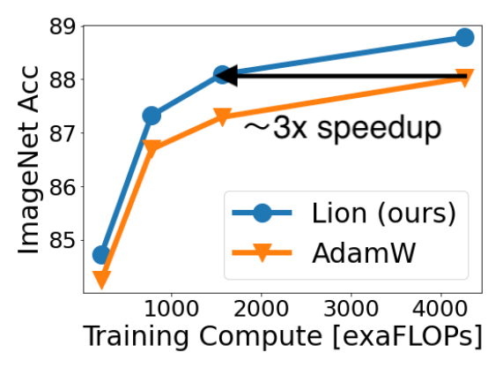
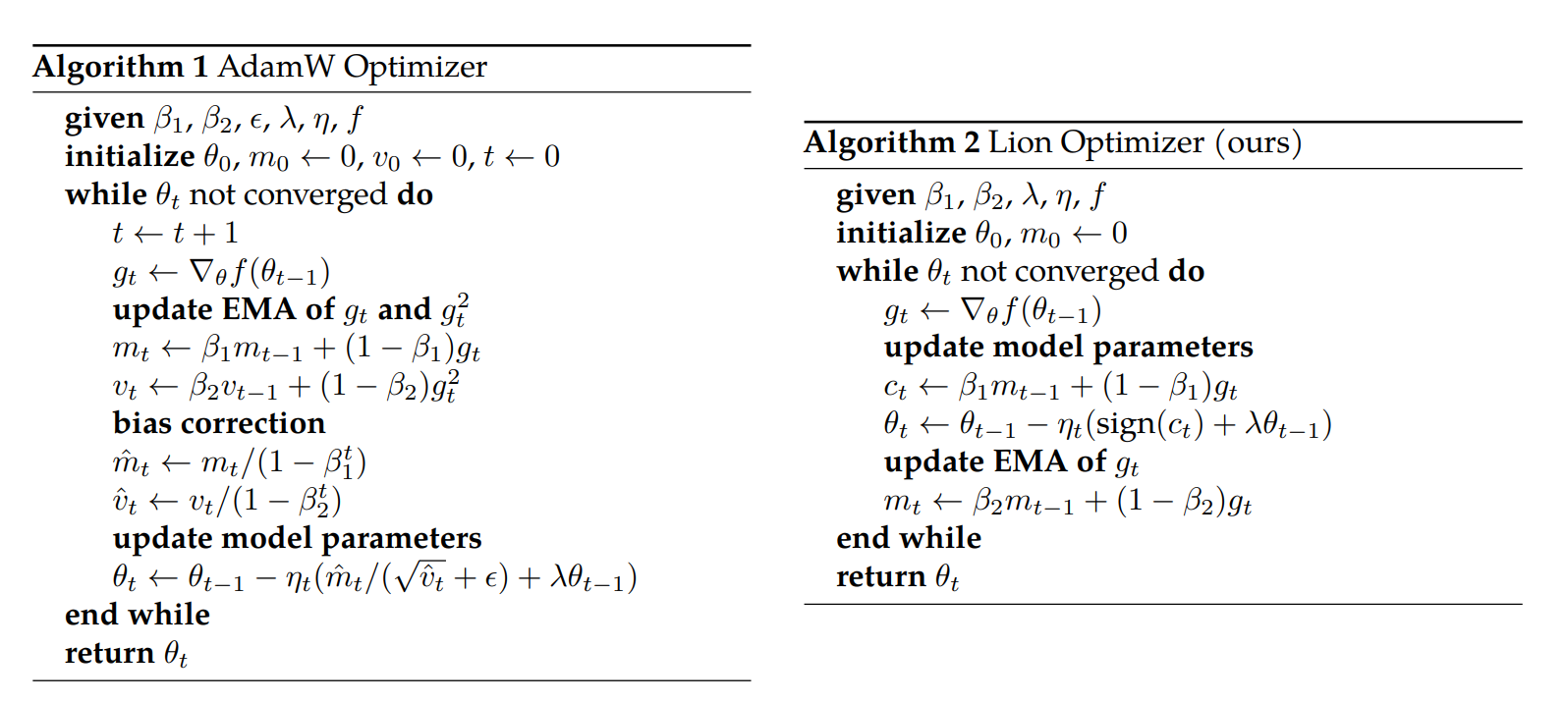
Lion: evoLved sIgn mOmeNtum
Algorithm found by autoML; claims better than AdamW
https://arxiv.org/abs/2302.06675
https://medium.com/@yash9439/lion-optimizer-73d3fd18abe9

Slide 20
What to pick?
AdamW appears the most popular one for now
Other variants not extensively evaluated yet
Lion may be worth a try

Slide 21
Hyperparameter tuning

Slide 22
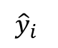
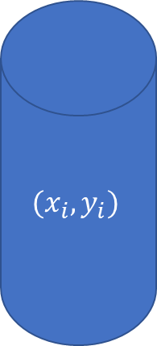
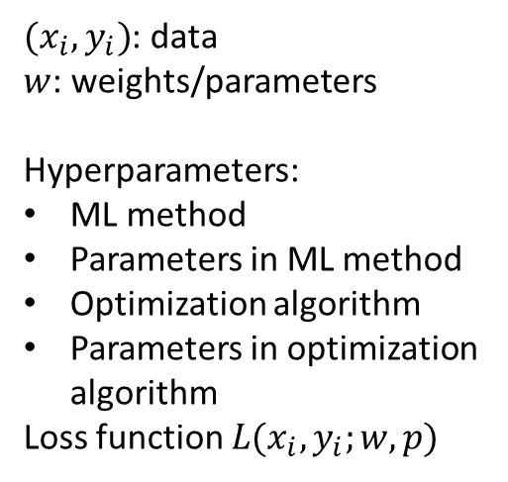
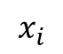
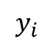
$(x_{i},y_{i})$: data
$w$: weights/parameters
Hyperparameters:
ML method
Parameters in ML method
Optimization algorithm
Parameters in optimization algorithm
Loss function $L(x_{i},y_{i};w,p)$
1: split data
Data
2: train/optimize
Training data
Train: optimize weights
$$(x_{i},y_{i})$$
w
Prediction machine
Test data
$$x_{i}$$
$${\hat{y}}_{i}$$
Loss
$$y_{i}$$
3: compute loss

Slide 23
Hyperparameter tuning
Need to choose from a large range of hyperparameters
NN:
Model parameters: activation function, number and size of layers
Optimization parameters: optimization algorithm, learning rate, epochs, batch size
Hyperparameter tuning techniques:
Manual search
Grid search
Random search
Bayesian optimization
Heuristics:
Nelder-Mead, Genetic, simulated annealing, ant colony, particle swarm
Derivative-free optimization:
Model-based: BOBYQA
Direct search: MADS/NOMAD

Slide 24
Bayesian optimization
Limited to low number of parameters
https://en.wikipedia.org/wiki/Bayesian_optimization
https://commons.wikimedia.org/wiki/File:GpParBayesAnimationSmall.gif
AnotherSamWilson, CC BY-SA 4.0, via Wikimedia Commons

Slide 25
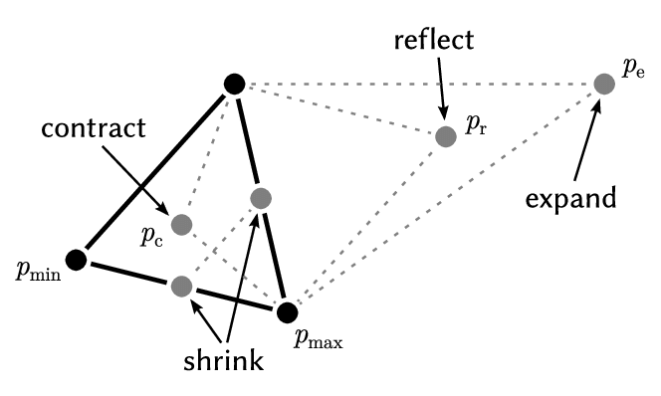
Nelder-Mead
https://commons.wikimedia.org/wiki/File:Nelder-Mead_Rosenbrock.gif
Nicoguaro, CC BY 4.0 <https://creativecommons.org/licenses/by/4.0>, via Wikimedia Commons
Direct search method.
No guarantee of global optimality
Heuristic, may converge to non-stationary points
https://commons.wikimedia.org/wiki/File:An-iteration-of-the-Nelder-Mead-method-over-two-dimensional-space-showing-point-p-min.png
Jade Yu ChengThomas Mailund, CC BY 4.0 <https://creativecommons.org/licenses/by/4.0>, via Wikimedia Commons
https://en.wikipedia.org/wiki/Nelder%E2%80%93Mead_method

Slide 26
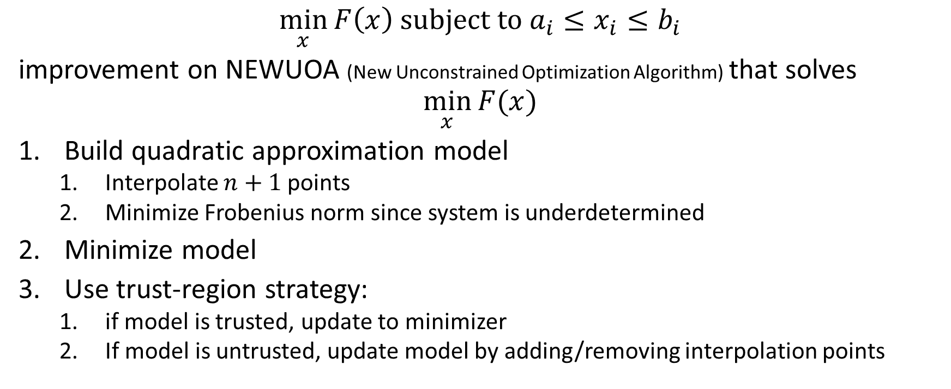
BOBYQA: Bound Optimization BY Quadratic Approximation
$$\min_{x}{F\left(x\right) subject to a_{i}≤x_{i}≤b_{i}}$$
improvement on NEWUOA (New Unconstrained Optimization Algorithm) that solves
$$\min_{x}{F(x)}$$
Build quadratic approximation model
Interpolate $n+1$ points
Minimize Frobenius norm since system is underdetermined
Minimize model
Use trust-region strategy:
if model is trusted, update to minimizer
If model is untrusted, update model by adding/removing interpolation points
https://www.damtp.cam.ac.uk/user/na/NA_papers/NA2004_08.pdf
https://www.damtp.cam.ac.uk/user/na/NA_papers/NA2009_06.pdf

Slide 27
Genetic algorithms
Evolved a population of candidate solutions
Start from randomly generated points (individuals) called a generation
Select a portion of the population
Generate a second generation
Crossover: mix characteristics of parents
Mutation
Keep looping until solution stabilize
https://en.wikipedia.org/wiki/Genetic_algorithm

Slide 28
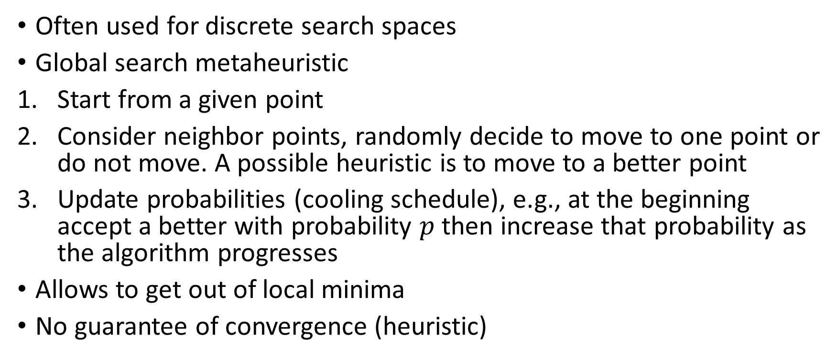
Simulated annealing
Often used for discrete search spaces
Global search metaheuristic
Start from a given point
Consider neighbor points, randomly decide to move to one point or do not move. A possible heuristic is to move to a better point
Update probabilities (cooling schedule), e.g., at the beginning accept a better with probability $p$ then increase that probability as the algorithm progresses
Allows to get out of local minima
No guarantee of convergence (heuristic)
https://en.wikipedia.org/wiki/Simulated_annealing

Slide 29
Ant colony
Artificial ant is computational agent searching for good solutions
Convert problem into finding shortest path on weighted graph
Each ant stochastically constructs a solution
Paths found by different ants are compared
Update pheromone levels on each edge (gradually forget old paths)
https://commons.wikimedia.org/wiki/File:Ant_Colony_Algorihm_applied_to_the_Travelling_Salesman_Problem.gif
Rodrigo Castro Freibott, CC BY-SA 4.0 <https://creativecommons.org/licenses/by-sa/4.0>, via Wikimedia Commons
https://en.wikipedia.org/wiki/Ant_colony_optimization_algorithms

Slide 30
Particle swarm
Population of candidate solution (swarm)
Move particle using simple formulas guided by particle position and swarm best position
Improved positions guide movements of the swarm
repeat
No guarantee of finding solution
https://commons.wikimedia.org/wiki/File:ParticleSwarmArrowsAnimation.gif
Ephramac, CC BY-SA 4.0 <https://creativecommons.org/licenses/by-sa/4.0>, via Wikimedia Commons
https://en.wikipedia.org/wiki/Particle_swarm_optimization

Slide 31
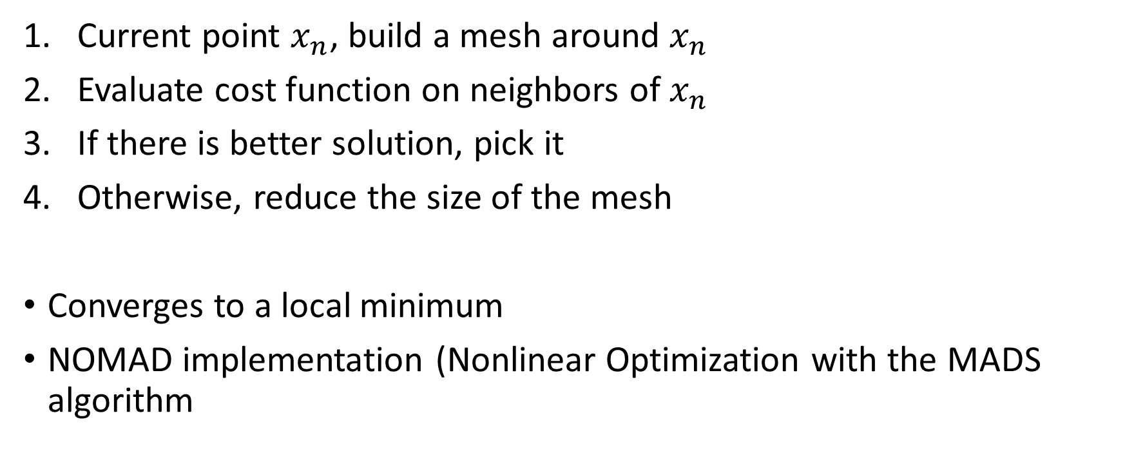
MADS: mesh adaptive direct search
Current point $x_{n}$, build a mesh around $x_{n}$
Evaluate cost function on neighbors of $x_{n}$
If there is better solution, pick it
Otherwise, reduce the size of the mesh
Converges to a local minimum
NOMAD implementation (Nonlinear Optimization with the MADS algorithm
https://commons.wikimedia.org/wiki/File:Direct_search_BROYDEN.gif
Guillaume Jacquenot, CC BY-SA 3.0 <https://creativecommons.org/licenses/by-sa/3.0>, via Wikimedia Commons
https://en.wikipedia.org/wiki/Pattern_search_%28optimization%29

Slide 32



Warning
A Gray Box Manifesto for Evolutionary Combinatorial Optimization https://dl.acm.org/doi/pdf/10.1145/3328473.3328474
Black box random search is doomed to fail, i.e., may as well use random search than a genetic algorithm
Gray box (using the problem structure) is the only way forward
Metaphor-based metaheuristics, a call for action: the elephant in the room https://link.springer.com/article/10.1007/s11721-021-00202-9
Useless metaphors
Lack of novelty
Poor experimental validation and comparison
This Photo by Unknown Author is licensed under CC BY-NC
This Photo by Unknown Author is licensed under CC BY-NC

Slide 33
Hyperparameter tuning
This is an optimization problem, why not use optimization algorithms?
Bayesian optimization
MADS (Mesh Adaptive Direct Search); implemented in HyperNOMAD https://arxiv.org/abs/1907.01698
Discrete parameter values so no derivative available
Loss function evaluations are extremely time consuming so limited to a very small number of function evaluations

Slide 34
Practically
Start with default parameters
If performance not acceptable, manual tuning
If still unacceptable: random search
Still not acceptable: Bayesian optimization, HyperNOMAD
Still not acceptable: Grid search
Avoid heuristics unless you really have no choice:
“Heuristics are for the ignorant or the desperate. There is nothing wrong with being desperate.” Andy Conn (paraphrased).

Slide 35
Quadratic programming

Slide 36
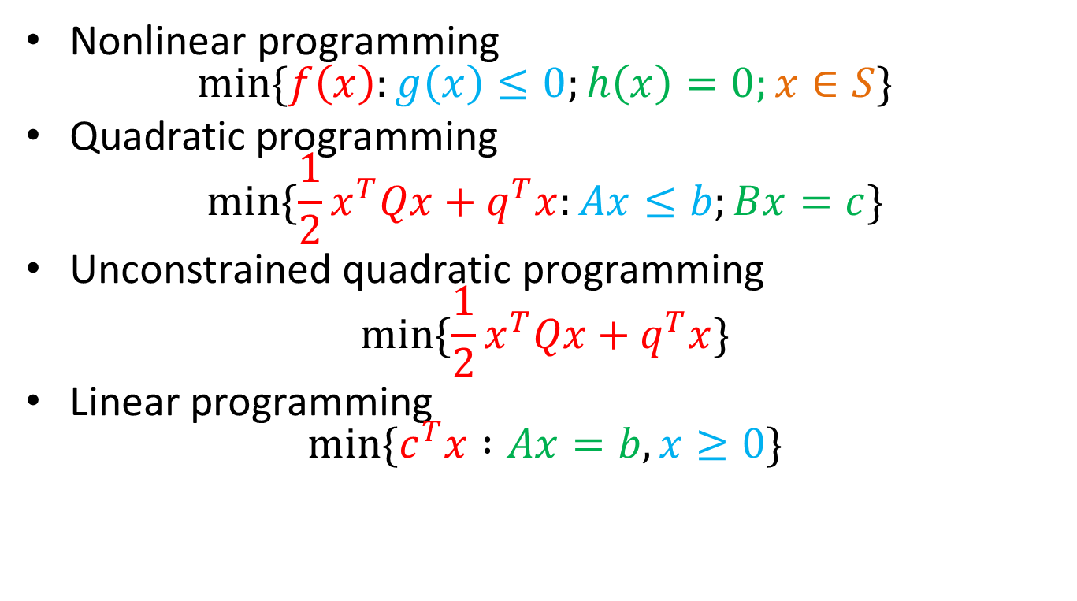
Nonlinear programming $\min{\{f\left(x\right):g\left(x\right)≤0;h\left(x\right)=0;x∈S\}}$
Quadratic programming $\min{\{\frac{1}{2}x^{T}Qx+q^{T}x:Ax≤b;Bx=c\}}$
Unconstrained quadratic programming $\min{\{\frac{1}{2}x^{T}Qx+q^{T}x\}}$
Linear programming $\min{\{c^{T}x :Ax=b, x≥0\}}$

Slide 37
Quadratic programming
Quadratic programming refer to minimizing a quadratic function under linear constraints
$$\min_{x}{\{\frac{1}{2}x^{T}Qx+q^{T}x} :Ax≤b\}$$
We start with the unconstrained version
$$\min_{x}{\frac{1}{2}x^{T}Qx+q^{T}x}$$

Slide 38
Unconstrained quadratic programming
$$\min_{x}{\frac{1}{2}x^{T}Ax−b^{T}x}$$
The critical points satisfy: $$Ax=b$$
BUT… solving Ax=b does not always return the minimum

Slide 39
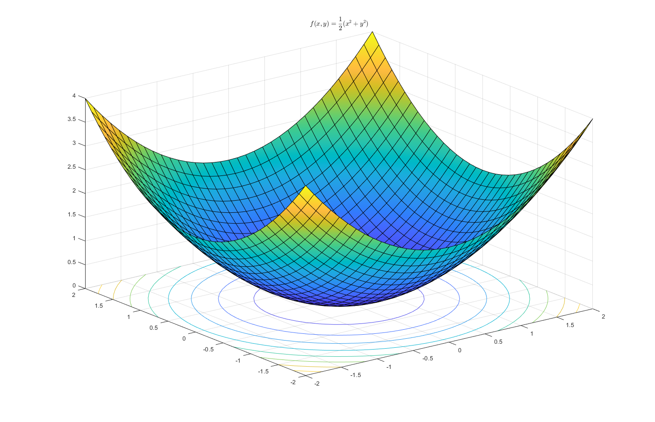

$f\left(x,y\right)=\frac{1}{2}[x y]\left[\begin{matrix}1 & 0 \\ 0 & 1\end{matrix}\right]\left[\begin{matrix}x \\ y\end{matrix}\right]$ with positive definite matrix so f is (strongly) convex quadratic

Slide 40
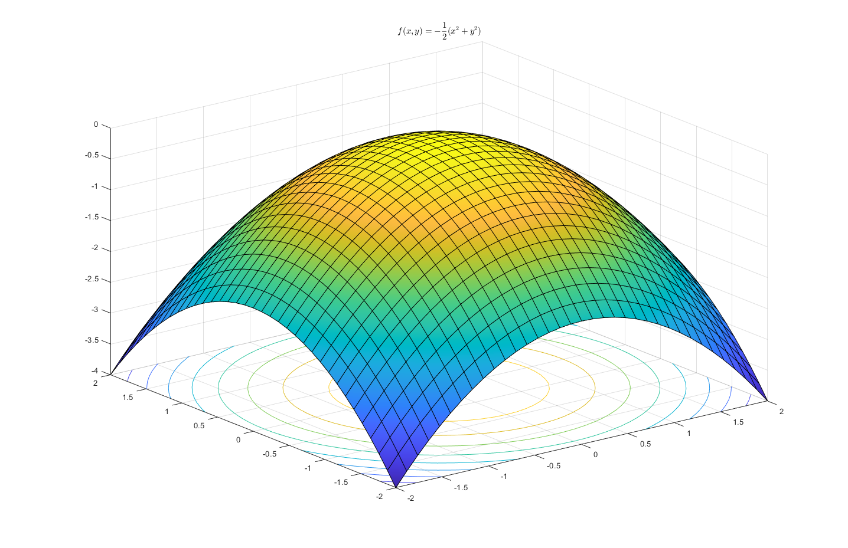

Slide 41
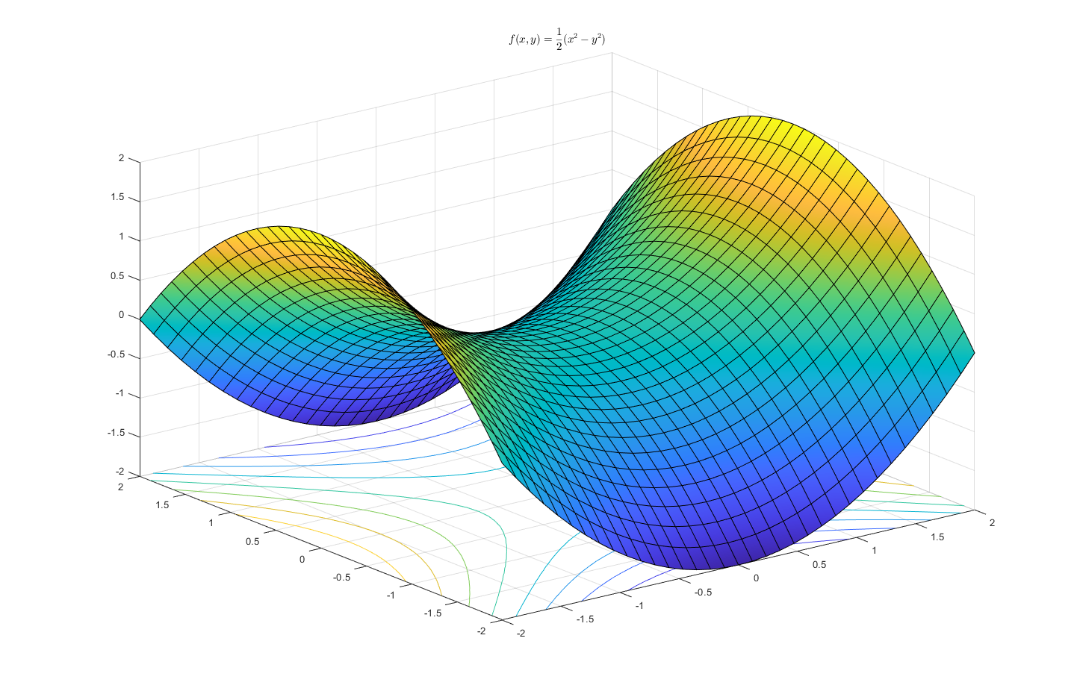

Slide 42

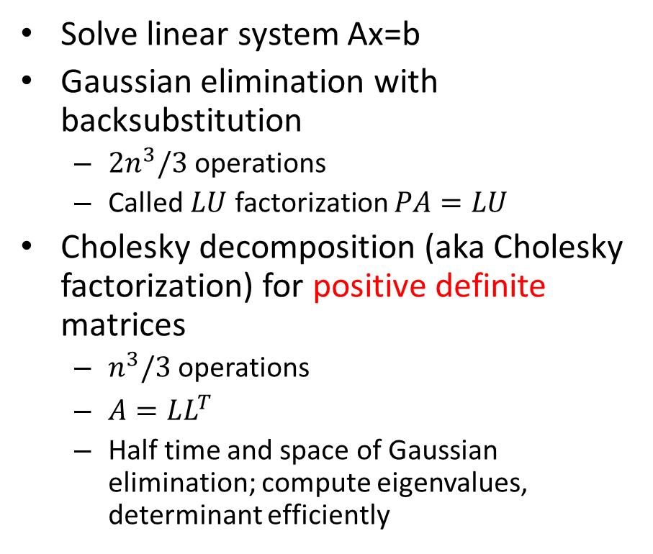
Direct vs. Iterative methods
Direct methods
Iterative methods
Solve linear system Ax=b
Gaussian elimination with backsubstitution
$2n^{3}/3$ operations
Called $LU$ factorization $PA=LU$
Cholesky decomposition (aka Cholesky factorization) for positive definite matrices
$n^{3}/3$ operations
$A=LL^{T}$
Half time and space of Gaussian elimination; compute eigenvalues, determinant efficiently
solve $\min_{x}{\frac{1}{2}x^{T}Ax−b^{T}x}$
conjugate gradient
best general purpose method

Slide 43
Conjugate gradient
most popular iterative method for solving large systems of linear equations $Ax=b$
effective when A is square symmetric positive-definite and sparse [iterative method]
When A is dense, best to factor A and solve by backsubstitution [direct method]
Notes:
Direct method: Gaussian elimination, Cholesky factorization

Slide 44

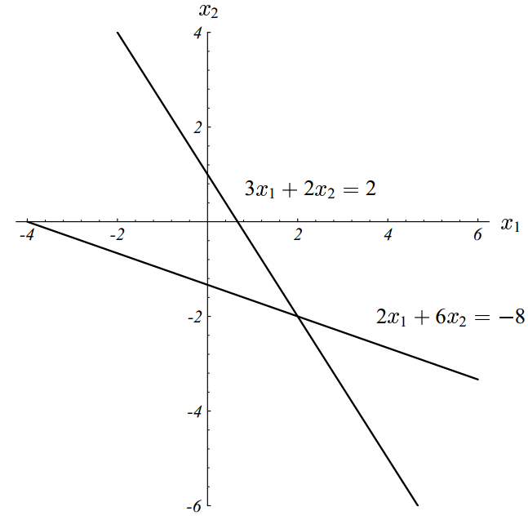

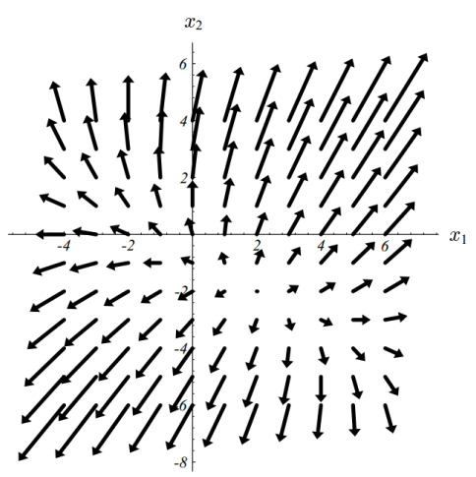
Quadratic form
$$Ax=b$$
$$\min{\frac{1}{2}x^{T}Ax−b^{T}x}$$
Notes:
Left: the solution to the system is at the intersection of the 2 lines
right: plot of the quadratic function, contour plot, and gradient

Slide 45
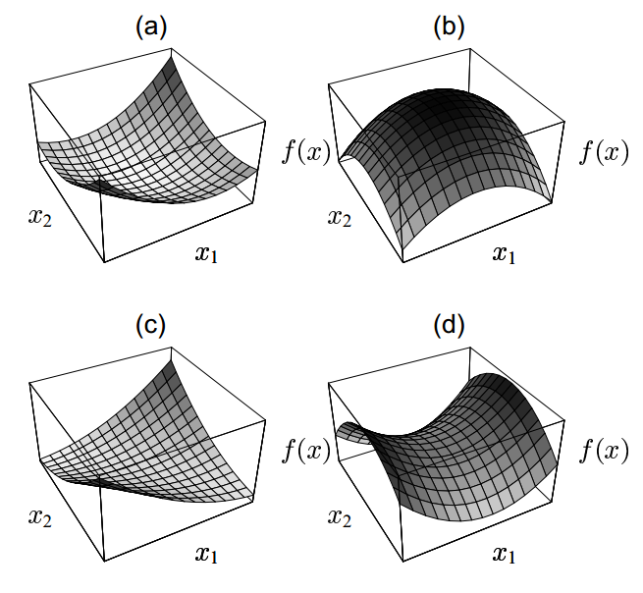
Quadratic form
$f\left(x\right)=\frac{1}{2}x^{T}Ax−b^{T}x+c$ $∇f\left(x\right)=Ax−b$
Notes:
Always assume A is symmetric

Slide 46
A is symmetric positive definite
from now on

Slide 47
Minimize $f\left(x\right)=\frac{1}{2}x^{T}Ax−b^{T}x$
Proof that any critical point is a minimum
Assume $x$ satisfies $Ax=b$ and A symmetric so $e^{T}Ax=x^{T}Ae∈ℝ$ $$f\left(x+e\right)=\frac{1}{2}{\left(x+e\right)}^{T}A\left(x+e\right)−b^{T}\left(x+e\right) \\ =\frac{1}{2}x^{T}Ax+e^{T}Ax+\frac{1}{2}e^{T}Ae−b^{T}x−b^{T}e \\ =\frac{1}{2}x^{T}Ax−b^{T}x+e^{T}b+\frac{1}{2}e^{T}Ae−b^{T}e \\ =f\left(x\right)+\frac{1}{2}e^{T}Ae$$
Since A is positive definite, $e^{T}Ae>0$ for any $e≠0$. Hence, x is a minimizer
Notes:
So x is a minimizer since ½ e^T A e is positive when A is positive definite, i.e. any point x+e has f(x+e) > f(x)

Slide 48
Conjugate gradient: the plan
Steepest descent
Method of conjugate directions
Conjugate gradient
Fine tuning
rate of convergence
preconditioning

Slide 49
Steepest Descent: direction
$$\min_{x}{f(x)}$$
Input: $f, {∇f, x}_{0}, ε$
Output: $x^{∗}, f(x^{∗})$ such that $∀x∈B\left(x^{∗},ε\right), f\left(x^{∗}\right)<f\left(x\right)+ε$, i.e. $x^{∗}$ is a local $ε$-minimizer
Algorithm
Start at point $x_{0}$
Update $x_{k+1}=x_{k}+αd_{k}$ such that $f(x_{k+1})$ is as small as possible using only information $x_{k}, f\left(x_{k}\right), ∇f(x_{k})$
$d_{k}=−∇f(x_{k})$ is called the steepest descent direction since it is the direction along which $f$ decreases most rapidly
Notes:
residual is the steepest descent direction
alpha is the stepsize giving the steepest decrease. Setting derivative to 0 gives that alpha should be chosen so that r0 is orthogonal to \nabla f(x1)=-r1

Slide 50
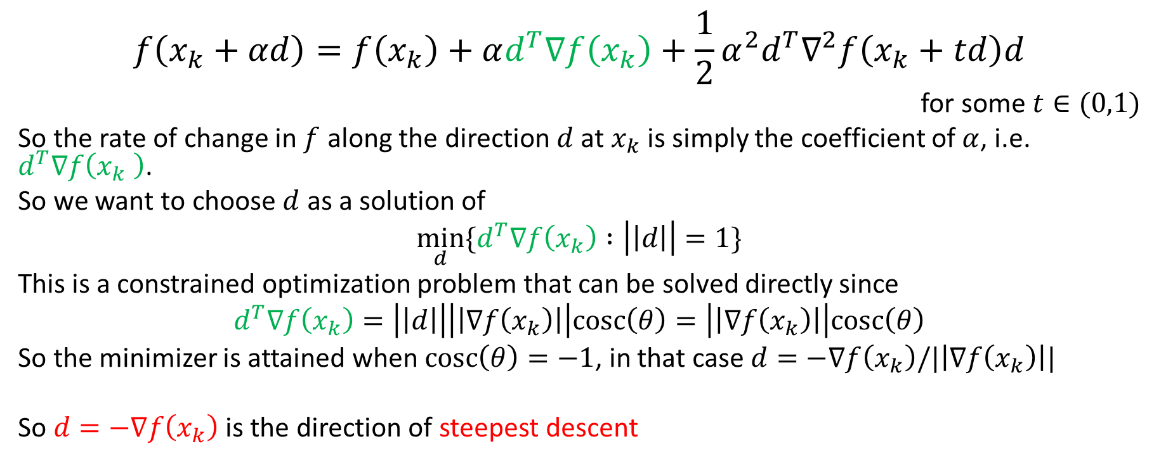
Steepest Descent: proof
$$f\left(x_{k}+αd\right)=f\left(x_{k}\right)+αd^{T}∇f\left(x_{k}\right)+\frac{1}{2}α^{2}d^{T}∇^{2}f\left(x_{k}+td\right)d$$
for some $t∈(0,1)$
So the rate of change in $f$ along the direction $d$ at $x_{k}$ is simply the coefficient of $α$, i.e. $d^{T}∇f\left(x_{k} \right)$.
So we want to choose $d$ as a solution of
$$\min_{d}{\{d^{T}∇f\left(x_{k}\right) :\left|\left|d\right|\right|=1\}}$$
This is a constrained optimization problem that can be solved directly since
$$d^{T}∇f\left(x_{k}\right)=\left|\left|d\right|\right|\left|\left|∇f\left(x_{k}\right)\right|\right|cosc\left(θ\right)=\left|\left|∇f\left(x_{k}\right)\right|\right|cosc\left(θ\right)$$
So the minimizer is attained when $cosc\left(θ\right)=−1$, in that case $d=−∇f\left(x_{k}\right)/|\left|∇f\left(x_{k}\right)\right||$
So $d=−∇f\left(x_{k}\right)$ is the direction of steepest descent

Slide 51
Steepest Descent: stepsize
Remember we want to iterate
$$x_{k+1}=x_{k}+αd_{k}$$
we will take $d_{k}=−∇f(x_{k})$.
Now we need to pick $α$ to minimize $f(x_{k+1})$ as much as possible
$$\min_{α∈ℝ}{f(x_{k}+αd_{k})}$$

Slide 52
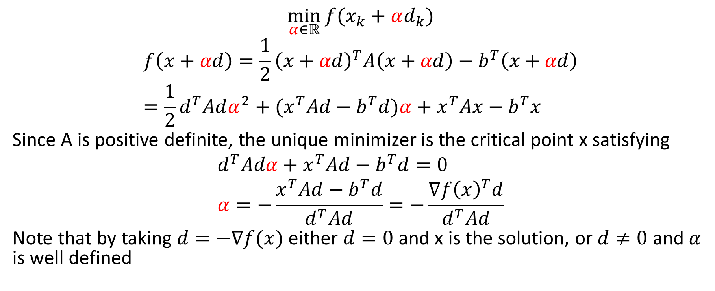
Steepest Descent: stepsize
$$\min_{α∈ℝ}{f(x_{k}+αd_{k})}$$
$$f\left(x+αd\right)=\frac{1}{2}{\left(x+αd\right)}^{T}A\left(x+αd\right)−b^{T}\left(x+αd\right) \\ =\frac{1}{2}d^{T}Adα^{2}+(x^{T}Ad−b^{T}d)α+x^{T}Ax−b^{T}x$$
Since A is positive definite, the unique minimizer is the critical point x satisfying
$$d^{T}Adα+x^{T}Ad−b^{T}d=0 \\ α=−\frac{x^{T}Ad−b^{T}d}{d^{T}Ad}=−\frac{∇f{\left(x\right)}^{T}d}{d^{T}Ad}$$
Note that by taking $d=−∇f(x)$ either $d=0$ and x is the solution, or $d≠0$ and $α$ is well defined

Slide 53
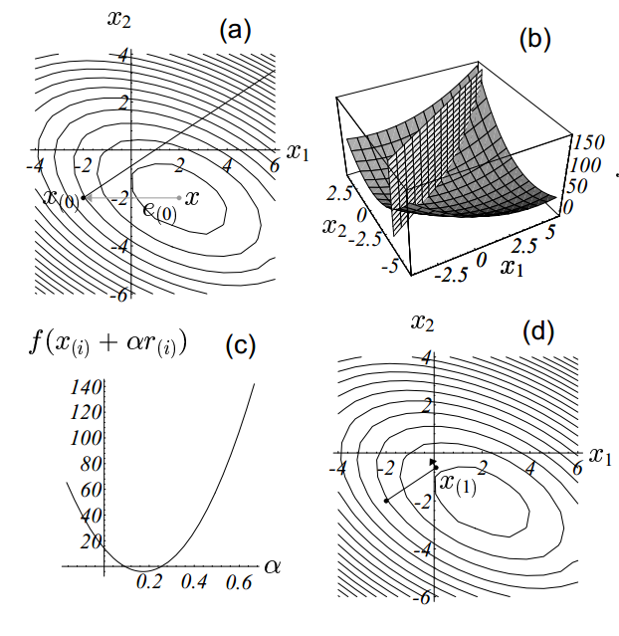

Slide 54
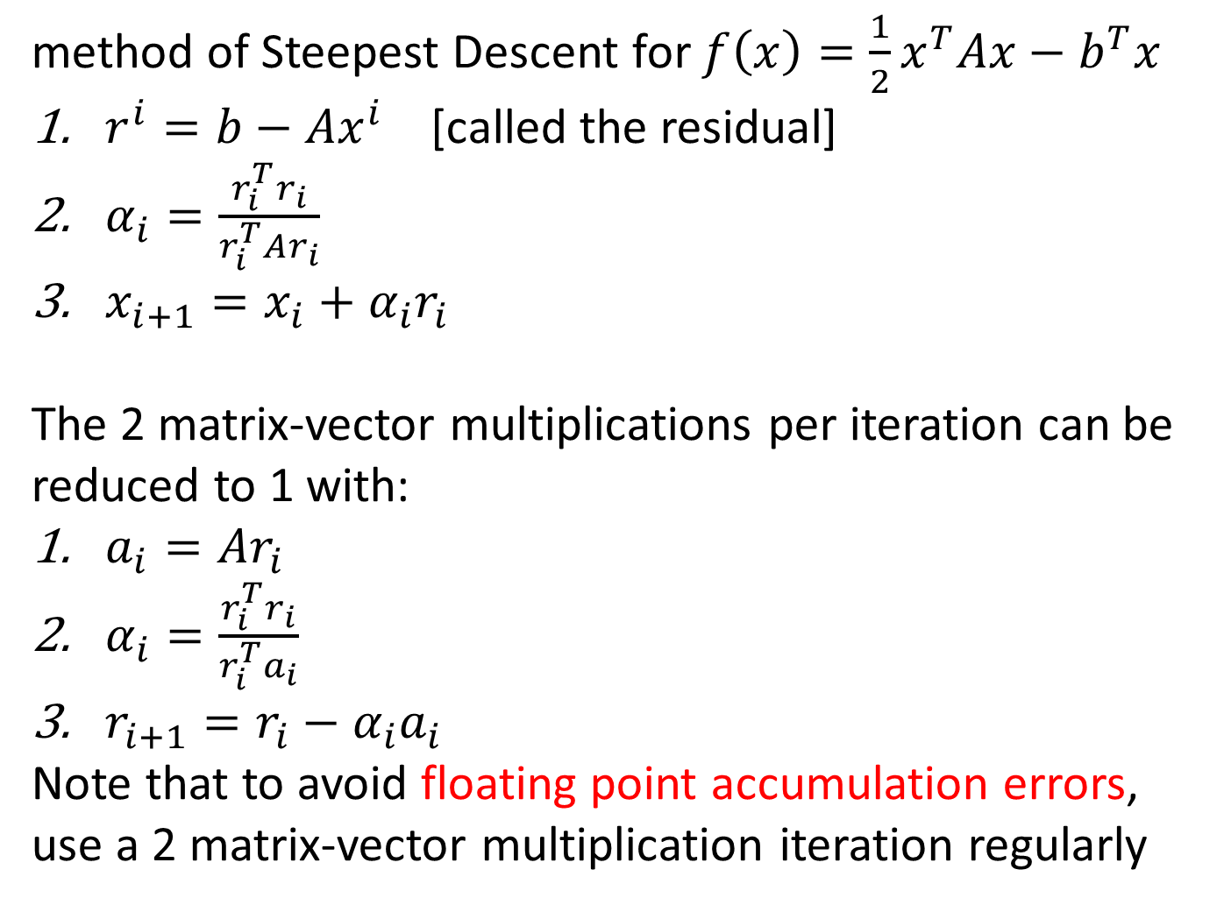
method of Steepest Descent for $f\left(x\right)=\frac{1}{2}x^{T}Ax−b^{T}x$
$r^{i}=b−Ax^{i}$ [called the residual]
$α_{i}=\frac{r_{i}^{T}r_{i}}{r_{i}^{T}Ar_{i}}$
$x_{i+1}=x_{i}+α_{i}r_{i}$
The 2 matrix-vector multiplications per iteration can be reduced to 1 with:
$a_{i}=Ar_{i}$
$α_{i}=\frac{r_{i}^{T}r_{i}}{r_{i}^{T}a_{i}}$
$r_{i+1}=r_{i}−α_{i}a_{i}$
Note that to avoid floating point accumulation errors, use a 2 matrix-vector multiplication iteration regularly

Slide 55
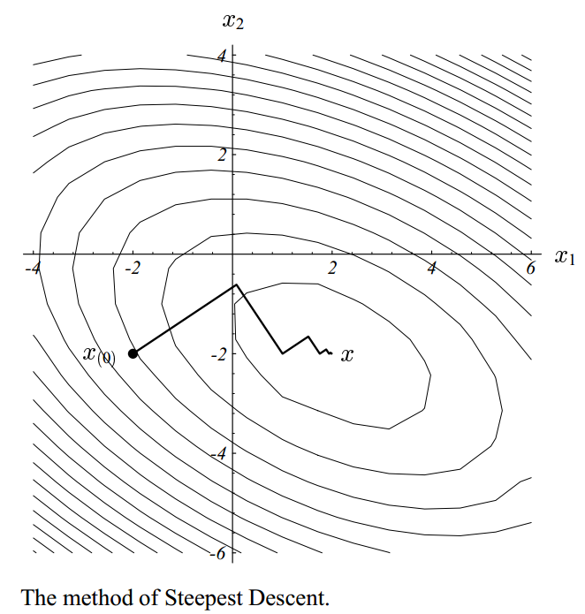
Notes:
zigzag path

Slide 56
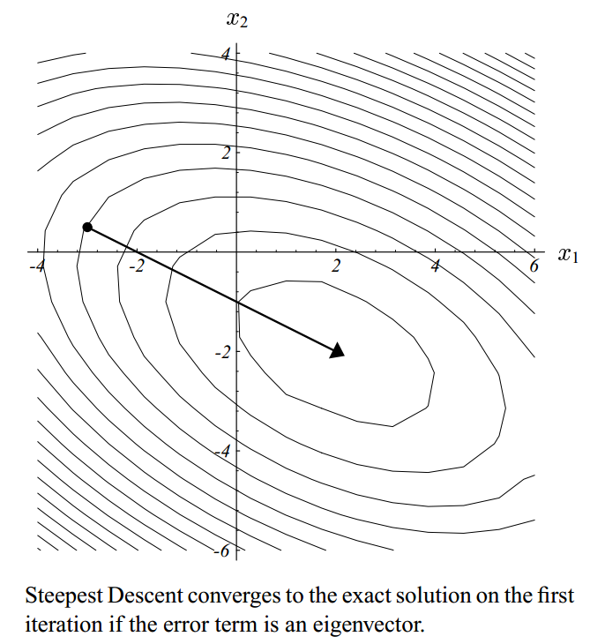
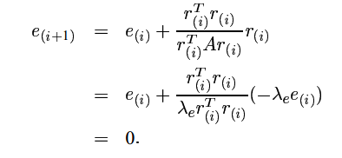
Steepest Descent
$e_{i}=x_{i}−x^{∗}$ error vector
If $e_{i}$ is an eigenvector of A with eigenvalue $λ_{e}$ then residual $r_{i}=−Ae_{i}=−λ_{e}e_{i}$ and
Notes:
Converges in 1 step with $α_{i}=1/λ_{e}$

Slide 57
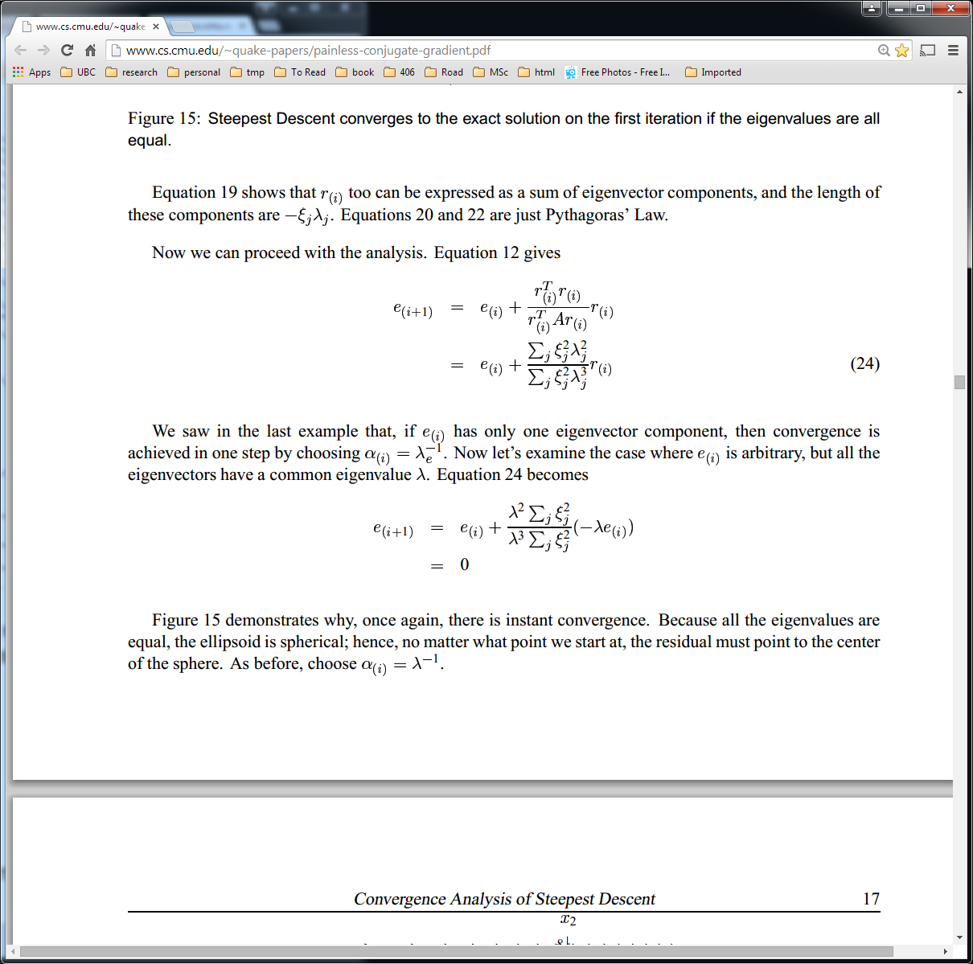
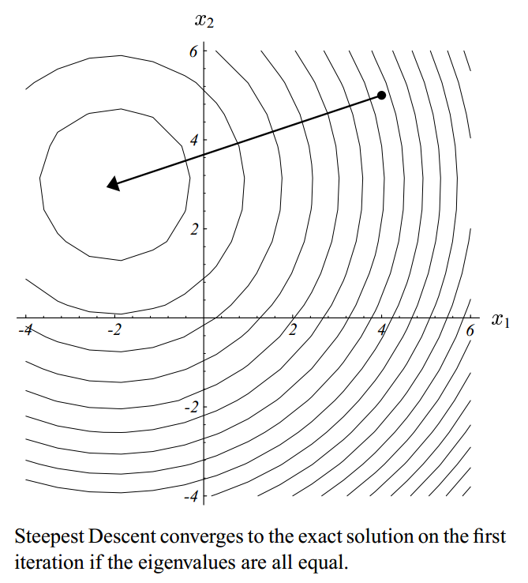

Steepest Descent
$e_{i}$ is arbitrary but A single eigenvalue $λ$

Slide 58
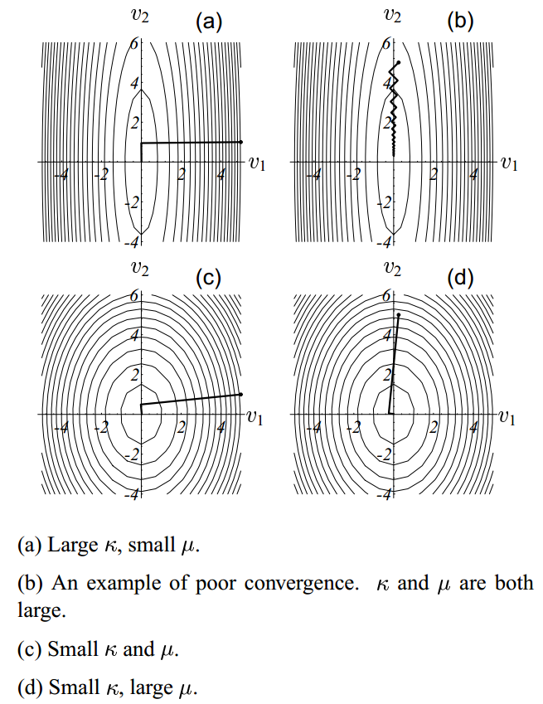
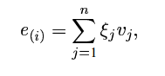
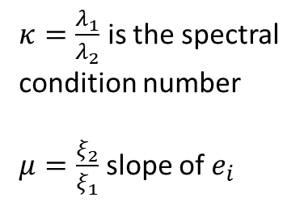
$κ=\frac{λ_{1}}{λ_{2}}$ is the spectral condition number
$μ=\frac{ξ_{2}}{ξ_{1}}$ slope of $e_{i}$
Notes:
quick convergence due to fortunate starting point
slow convergence is more typical, x oscillates around a valley going to the minimum
and (d) have small condition number so the contours are almost spherical leading to quick convergence

Slide 59
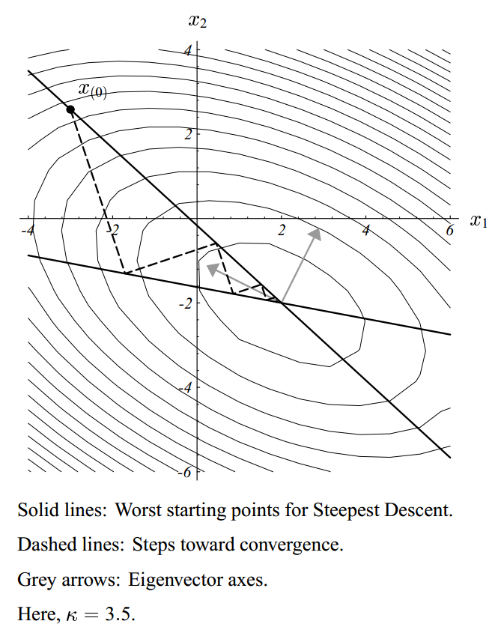
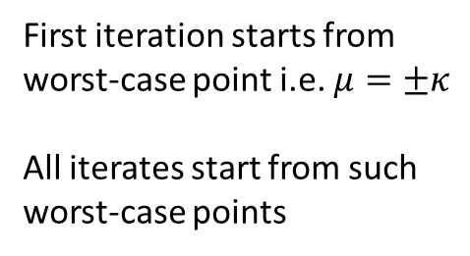
First iteration starts from
worst-case point i.e. $μ=±κ$
All iterates start from such
worst-case points

Slide 60

Method of conjugate directions
Steepest descent often takes steps in same direction as earlier steps
Idea: pick a set of orthogonal directions and take ONE step in each direction
use coordinate axis

Slide 61

Method of conjugate directions
WARNING: not implementable
Notes:
Need to know $e_{i}$ but if we did, the problem would be solve!

Slide 62

Method of conjugate directions
Solution: use A-orthogonal directions instead
A sym pos def defines a dot product
impose $d_{i}^{T}Ad_{j}=0$

Slide 63


Method of conjugate directions
New requirement:
$e_{i+1}$ A-orthogonal to $d_{i}$
Notes:
When $d_{i}=r_{i}$, this is steepest descent

Slide 64
Gram-Schmidt Orthogonalization process
Given n linearly independent vectors, build n A-orthogonal vectors
Need to keep all the old search vectors in memory and $O(n^{3})$ operations
Conjugate directions applied to axial unit vectors is equivalent to Gaussian elimination

Slide 65


Slide 66
Conjugate Gradients
method of conjugate directions where the search directions are constructed by conjugation of the residuals
residuals worked for Steepest Descent
residuals orthogonal to previous search directions
always linearly independent unless it is zero
if zero then we are done!
no longer need to store all old search directions $O\left(n^{2}\right)$ operations

Slide 67


Slide 68

Conjugate Gradients
$D_{i}=span \{r_{0},…, r_{i−1}\}$
in fact $D_{i}=span\left\{r_{0},Ar_{0}, …, A^{i−1}r_{0}\right\}$
Krylov subspace

Slide 69

Conjugate Gradients

Slide 70
Convergence

Slide 71
Convergence
Algorithm ends in less than d iterations (in exact arithmetic)
If A has only r distinct eigenvalues then CG terminates in at most r iterations
If A has eigenvalues $λ_{1}≤λ_{2}≤…≤λ_{n}$ ${\left|\left|x_{k+1}−x^{∗}\right|\right|}_{A}^{2}≤\left(\frac{λ_{n−k}−λ_{1}}{λ_{n−k}+λ_{1}}\right){\left|\left|x_{0}−x^{∗}\right|\right|}_{A}^{2}$

Slide 72
Preconditioning

Slide 73

Preconditioning
$\hat{x}=Cx$ then solving Ax=b is replaced by solving $\left(C^{−T}AC^{−1}\right)\hat{x}=C^{−T}b$
Rate of convergence depends on $C^{−T}AC^{−1}$
Choose C such that $C^{−T}AC^{−1}$ eigenvalues are spread more favorably
Pick C such that either
Condition number of $C^{−T}AC^{−1}$ is much smaller
Eigenvalues of $C^{−T}AC^{−1}$ are clustered

Slide 74



Slide 75

Practical preconditioners
No single best preconditioner
Tradeoff between computing preconditioner vs. applying CG
Good conditioners known for specific matrices
General purpose conditioners proposed by effectiveness varies depending on A
Symmetric successive overrelaxation (SSOR)
Banded preconditioners
Incomplete Cholesky (most effective in general)
Apply Cholesky but instead of $A=LL^{T}$ find approximate factor $\tilde{L}$ that is sparser than L. Then $A≈$ $\tilde{L}$ ${\tilde{L}}^{T}$ and pick $C={\tilde{L}}^{T}$
If $\tilde{L}$ is not sufficiently positive definite, increase values of diagonal elements. That makes $\tilde{L}$ more dense and increase computation costs.

Slide 76
Summary
Adaptive gradient descent for ML: AdamW
Hyperparameter tuning
Minimizing a quadratic function without constraints

Slide 77
Selected references
An overview of gradient descent optimization algorithms, Ruder, 2017 https://arxiv.org/pdf/1609.04747.pdf
An Introduction to the Conjugate Gradient Method Without the Agonizing Pain J. R. Shewchuk, 1994 http://www.cs.cmu.edu/~quake-papers/painless-conjugate-gradient.pdf
Trust-Region methods, Conn, Gould, Toint, 2000; Chapter 5

